Slide 1
LINQ Concepts in C#
Benadex Johnson

Slide 2
Agenda
LINQ
LINQ API
LINQ Query syntax
LINQ Method syntax
Lambda Expression
Standard Query Operators
Examples

Slide 3
LINQ
LINQ stands for Language Integrated Query
Used to retrieve data from different data sources and formats
Eliminates mismatch between programming languages and databases
Provides a single querying interface for different types of data sources
Like SQL is used to access data from database LINQ is used to access data from collections, ADO.Net, XML, MSSQL etc.,
LINQ queries returns results as objects eliminating the need to transform different formats of results into objects
LINQ must be executed in order to retrieve data from various sources like array, collections, XML or databases

Slide 4
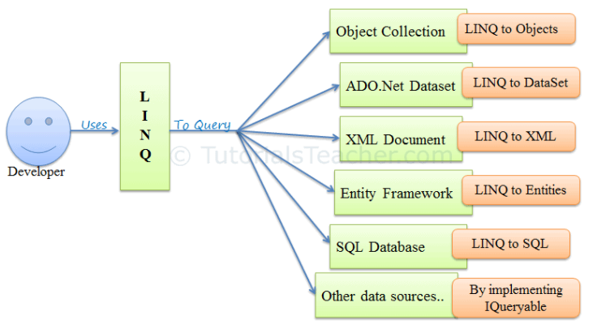
LINQ Structure

Slide 5
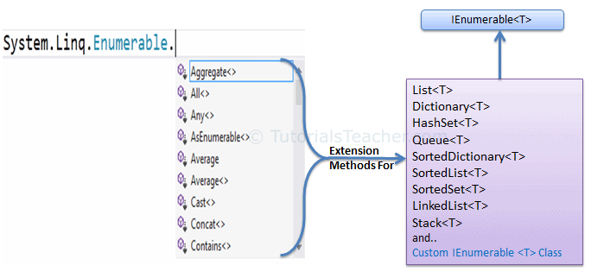
LINQ API
LINQ queries can be written to classes that implement IEnumerable and IQueryable interface using System.Linq namespace
Enumerable:
Enumerable class includes extension methods for classes that implement IEnumerable interface
All built in collection classes implement this interface so we can retrieve data using LINQ queries

Slide 6
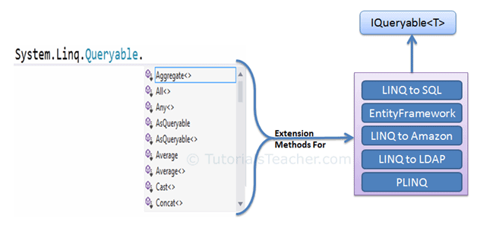
LINQ API
Queryable:
Queryable class includes extension methods for classes that implement IQueryable interface
Used to provide querying capabilities against a specific data source where the type of the data is known
Entity framework API implements IQueryable interface to support LINQ queries with databases like MS SQL
It also lets us access third party data like LINQ to Amazon with AWS

Slide 7
LINQ Query Syntax
There are 2 basic ways to write LINQ queries
Query Syntax or Query Expression Syntax
Method Syntax or Method Extension Syntax or Fluent

Slide 8
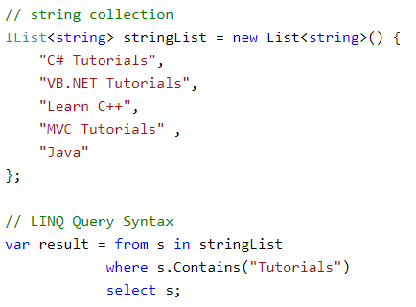
Query Syntax
Query syntax is similar to SQL (Structured Query Language) for the database
The LINQ query syntax starts with from keyword and ends with select keyword

Slide 9
Points to remember
As the name suggests Query syntax is similar to SQL query
Query syntax starts with from clause and ends with select or group by clause
Users can also add additional sorting, filtering, joining, grouping operators to get the desired results
Implicitly typed variable var can be used to store the result of LINQ Query

Slide 10
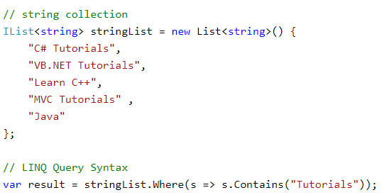
Method Syntax
Method syntax (also known as fluent syntax) uses extension methods included in the Enumerable or Queryable static class, similar to how you would call the extension method of any class
The compiler converts query syntax into method syntax at compile time

Slide 11
Points to remember
As the name suggests Method syntax is like calling an extension method
LINQ Method Syntax aka Fluent syntax because it allows series of extension methods call
Implicitly typed variable var can be used to store the result of LINQ Query

Slide 12
Lambda Expressions
The lambda expression is a shorter way of representing anonymous method using some special syntax
delegate(Student s) { return s.Age > 12 && s.Age < 20; };
Same can be written in lambda expression as follows
s => s.Age > 12 && s.Age < 20
Lambda expressions eliminates the need for complex syntax and increases readability
Also supports multiple parameters and multiple statements

Slide 13
Standard Query Operators
Standard Query Operators in LINQ are actually extension methods for the IEnumerable and IQueryable types
There are over 50 standard query operators available in LINQ that provide different functionalities like filtering, sorting, grouping, aggregation, concatenation, etc.
Where:
The Where operator (LINQ extension method) filters the collection based on a given criteria expression and returns a new collection. The criteria can be specified as lambda expression
var filteredResult = studentList.Where(s => s.Age > 12 && s.Age < 20);

Slide 14
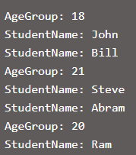
Standard Query Operators
GroupBy:
The GroupBy operator returns a group of elements from the given collection based on some key value
The result of GroupBy operators is a collection of groups
var groupedResult = studentList.GroupBy(s => s.Age);

Slide 15
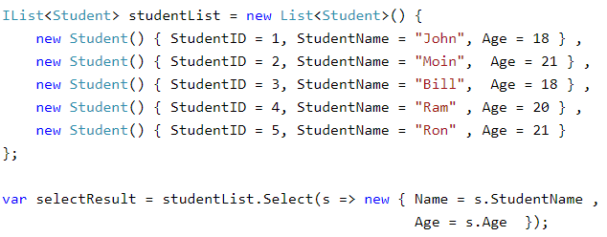
Standard Query Operators
Select:
The Select operator always returns an IEnumerable collection which contains elements based on a transformation function
It is similar to the Select clause of SQL that produces a flat result set

Slide 16
Standard Query Operators
ElementAt:
The ElementAt() method returns an element from the specified index from a given collection. If the specified index is out of the range of a collection then it will throw an Index out of range exception. Please note that index is a zero based index.
ElementAtOrDefault:
The ElementAtOrDefault() method also returns an element from the specified index from a collection and if the specified index is out of range of a collection then it will return a default value of the data type instead of throwing an error.

Slide 17
Standard Query Operators
First:
The First() method returns the first element of a collection, or the first element that satisfies the specified condition using lambda expression or Func delegate. If a given collection is empty or does not include any element that satisfied the condition then it will throw InvalidOperation exception.
FirstOrDefault:
The ElementAtOrDefault() method also returns an element from the specified index from a collection and if the specified index is out of range of a collection then it will return a default value of the data type instead of throwing an error.
Similar methods are available for last element in sequence. Last() and LastOrDefault()

Slide 18
Standard Query Operators
SequenceEqual:
Used to compare two sequences or enumerabe objects of same type.
The SequenceEqual method compares the number of items and their values for primitive data types
Distinct:
Returns distinct values from a collection
Except:
Returns the difference between two sequences, which means the elements of one collection that do not appear in the second collection
Intersect:
Returns the intersection of two sequences, which means elements that appear in both the collections
Union:
Returns unique elements from two sequences, which means unique elements that appear in either of the two sequences.

Slide 19
Examples & Questions

Slide 20
Thank You!!!

